Slide 1

Post-Discharge Care Plan Generator using Patient Records
Team Members:
NAME | ROLL NO | USN
Rakshita Kulkarni | 422 | 01FE23BCS155
Sushant Tiwari | 415 | 01FE23BCS086
Bhoomi Deshpande | 420 | 01FE23BCS045
Pramod G | 462 | 01FE23BCS056

Slide 2
Problem Statement
Patients discharged from hospitals often receive generic discharge summaries that do not account for their specific comorbidities or lifestyle. Build a GenAI system that takes structured patient discharge data and generates a personalised post-discharge care plan with medication schedule, dietary guidelines, follow-up milestones, and red-flag warnings.

Slide 3
Objectives
Structured patient data input form (diagnosis, medications, comorbidities)
Personalised care plan with 4 sections: meds, diet, follow-up, warnings
Output as printable DOCX/PDF, Validation on 3 different patient profiles (cardiac, diabetic, orthopaedic). Readability score (Flesch-Kincaid) of generated output

Slide 4
Data set :NHANES
File | Purpose
DEMO_L.XPT | Demographics
DIQ_L.XPT | Diabetes Indicators
BPQ_L.XPT | Blood Pressure
RXQ_RX_L.XPT | Medication Records

Slide 5
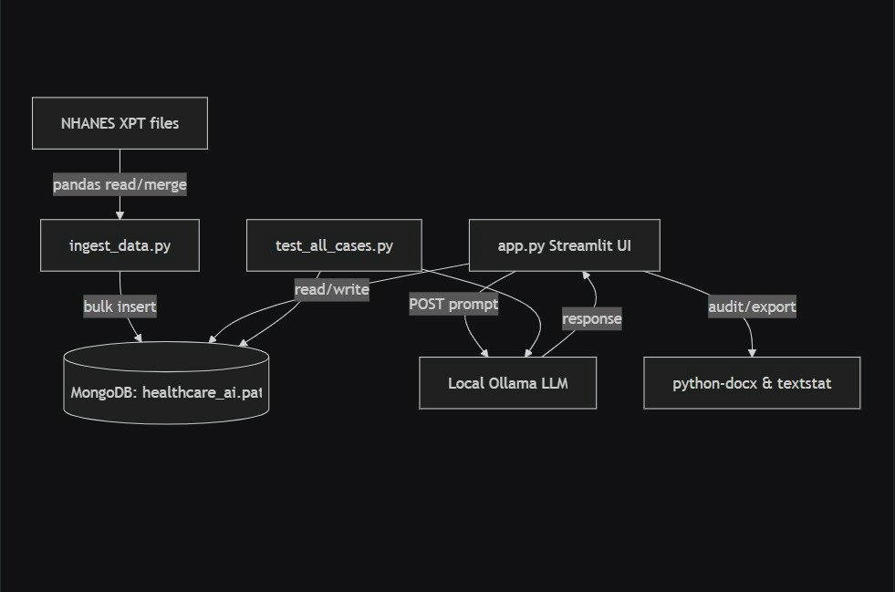
Architecture Pipeline:

Slide 6
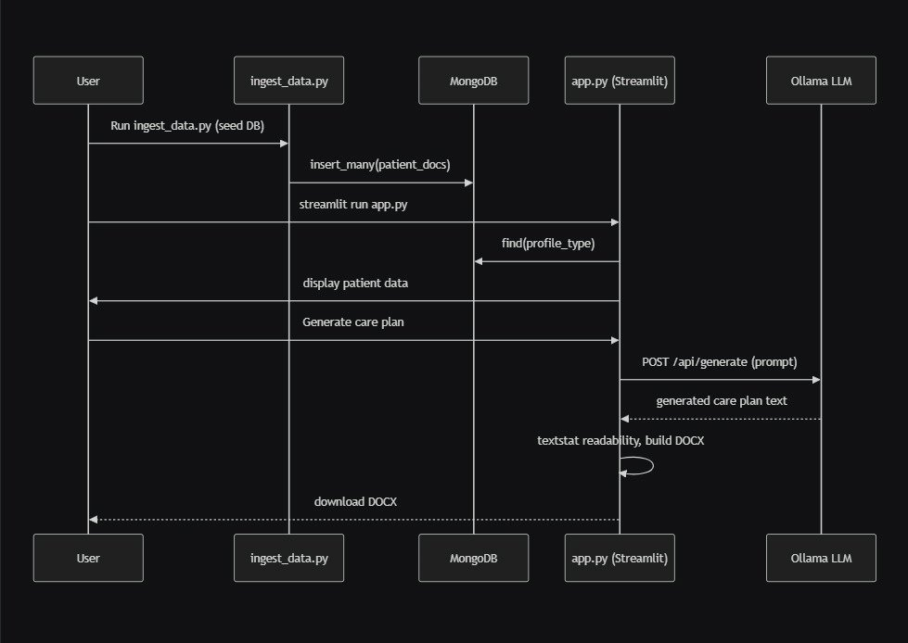
Architecture Flow
Aggregator Transformation
Sorter Transformation

Slide 7
Thank You
School of Computer Science and Engineering

